Slide 1

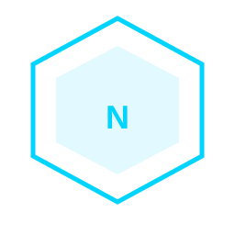
Our Team Has a Superpower.
You Just Don't Know It Yet.
Introducing Nexus — the AI assistant/agent that knows our team, our cloud platform, and how to act on both.
N E X U S
1
Notes:
This is the hook. Pause on the headline. Let it land. Nexus is the superpower your team doesn't know it has.

Slide 2
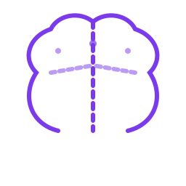
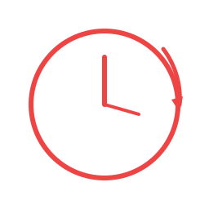

N E X U S
THE PROBLEM
Every Platform team fights the same three battles.
×
SCATTERED KNOWLEDGE
REPEATED QUESTIONS
AI THAT ADVISES
BUT CAN'T ACT
Decisions live in Azure DevOps nobody reads. Runbooks nobody finds. Patterns in senior engineers' heads that walk out the door.
"How do we deploy this?" "What did we decide about multi-region?" "Which tags are required?" — asked again and again, answered from scratch every time.
PairD suggests a command. We copy it. It fails. We Google why. The AI was never part of our infrastructure — just next to it.
2
Notes:
These aren't complaints. They're structural gaps that every cloud team has. Nexus closes all three.

Slide 3

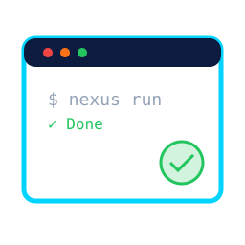
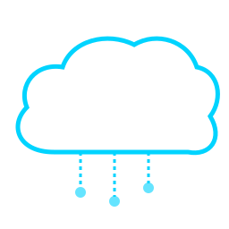

N E X U S
THE VISION
OUR KNOWLEDGE BASE
Team Azure DevOps Repos, runbooks, patterns, decisions
— all searchable by AI
TOOLS THAT
EXECUTE
LIVE Cloud
INTELLIGENCE
Not 'here's a command.'
Nexus runs it. Only after we approve.
Query our real infrastructure.
Cost, health, compliance — real time.
SWITCHABLE AI SKILLS
Architect mode. Engineer mode. Security mode.
Our rules. Our individual persona.
3
Notes:
Nexus is not a chatbot. It's an AI agent that combines your team's knowledge, your Azure environment, and a growing toolkit of capabilities — all in one place.

Slide 4
N E X U S
HOW IT WORKS
Ask. Think. Act. Learn.
1
Engineer asks a question
FOR EXAMPLE
2
Nexus reads our KB
"Find all VMs without required tags and show me a diagram."
team wiki, ADO Repos, runbooks
3
Picks the right tools
24 tools: search, query, execute, diagram
search_kb
Found tagging ADR
4
Asks for approval
only for actions that change things
az_resource_graph
14 untagged VMs found
5
Executes. Shows results.
real Cloud data, real output
diagram_gen
Architecture diagram created
6
Records what it learned
gets smarter for next time
4
Notes:
The loop runs up to 15 times per query. The agent isn't answering from training data — it's reasoning over your actual environment.

Slide 5

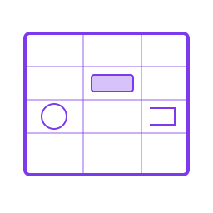


N E X U S
SKILLS SYSTEM
Switch roles. Change everything.
A Skill defines who Nexus is, how it thinks, and what it can do.
Chat with KB
Architect Mode
Security Reviewer
Your Custom Skill
Full-access general assistant. Searches our KB, queries Cloud provider and config, generates files.
Senior cloud architect persona. Trade-off analysis. Markdown-style outputs. WAF alignment.
Audits our Cloud security posture. Policy compliance, Defender findings, RBAC gaps.
Write a markdown file. Push to Git. Nexus picks it up. Our rules, live in minutes.
Skills are markdown files. Any engineer can write one. No code. No deploy.
5
Notes:
Skills are the soul of Nexus. They encode how your team works — naming standards, approval policies, which tools to use in which order. A new joiner immediately inherits the wisdom of your most senior architect.

Slide 6
N E X U S
THE IMPACT
10x
FOR ARCHITECTS
Review our entire subscription against WAF Reliability pillar
faster than copy-pasting AI
suggestions into a terminal
What did we decide about multi-region? Does our current infra match?
0
Generate an architecture diagram for the East US environment
FOR ENGINEERS
knowledge lost when a
senior engineer leaves
Walk me through the incident response runbook and run diagnostics
∞
Find all App Services still on .NET 6 — show me the list
Why is our cost up this month? Which top resources are the culprit?
custom skills and tools our
team can build
Nexus doesn't just answer our questions. It acts on them.
6
Notes:
Every one of these happens in a single conversation. No portal. No copy-paste. No waiting for the senior engineer to be free.

Slide 7

N E X U S
This is what our team's AI will look like.
One platform. One knowledge. Our cloud. Our tools.
Phase 1
Phase 2
Phase 3
Foundation
Intelligence
Expansion
Core platform
10 tools live
Chat interface
Team KB loaded
Skills defined
Agent running
Custom skills
More tools added
Team adopting
The question isn't whether our team needs this.
It's how fast we can build it.
7
Notes:
Nexus is not a product we buy. It's a platform we own. Every piece of team knowledge added makes it smarter. Every new tool makes it more capable. It compounds.

